Slide 1
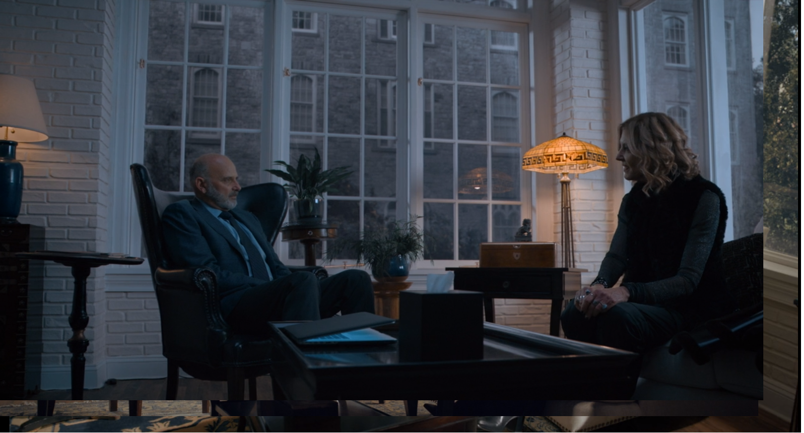
Overview
Measuring your strategic marketing plan’s success
Brand Equality definition
James Osibogun SNHU MBA 645 Karen fletcher April 28, 2024
Notes:
After 8 weeks, the U.S. Park Southeast developed a marketing plan we must pivot our strategy to introduce critical changes:
Collaborative efforts must focus on proactive crisis management and communication, ensuring we are prepared to address any issues swiftly and transparently(Miller, n.d.).
Enhance our social media monitoring and response strategies to manage online conversations and sentiment effectively(Chen, 2020).
Strengthen our Corporate Social Responsibility (CSR) communications to highlight our commitment to ethical practices and guest safety. Collaboration across departments is crucial for a cohesive response, aligning messaging, strategies, and action plans.

Slide 2
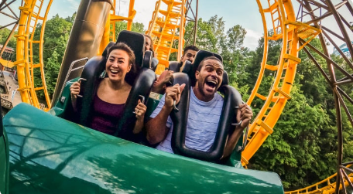
Overview
Brand Equality definition
1. What does brand equality mean
2. How does it impact the customer
Notes:
Brand equity is the value a brand has on a product or service. It's a measure of overall consumer perceptions of any brand, shaped by its customer experience (Big Commerce, n.d.). Brand equity encompasses brand awareness, loyalty, perceived quality, and associations. Hub spot states, “Brand equity can have a direct impact on sales and reputation for businesses.”(Carmicheal, 2020, pp.5)
Brand equity directly impacts market share, and overall brand perception, influencing consumer behavior and profitability as consumers are likelier to choose a brand they know and trust. This can lead to repeat purchases and a more stable customer base(Hayes, 2023). Customer retention measures how many customers continue to purchase your products or use your services over a period(Barron, 2023, pp.4).”Retaining customers means more returning business, which means more purchases without the need to guide customers through the funnel from interest to engagement to conversion(Barron, 2023, pp.4).”

Slide 3
Positive Implications
Reopening
1. safety measures
2. safety measure for customers and employees
Engagement
1.positive perception
2. effective relationships
reopening engagement
Notes:
A positive reputation can yield several benefits to the brand(Gupta,n.d.). Reopening with stringent safety measures enhances trust and loyalty among customers, boosting brand reputation. Health and safety have become the most crucial element of the customer experience. Taking the safety of consumers and employees is four times more important than delivering good customer service(Ipsos, 2020).
Positive community perception and governmental support contribute to brand credibility and favorable public relations. While marketing and advertising primarily aim to drive sales and revenue by directly promoting products or services to consumers, PR focuses on effective relationships to create a positive company image with its various publics. This includes stakeholders, customers, employees, and the media(Leibowitz, 2022).
To create a positive brand image, we must engage and support employees leading to better customer experiences. Employees who feel empowered and valued at work are likelier to deliver positive customer experiences(Linezero,2023).

Slide 4
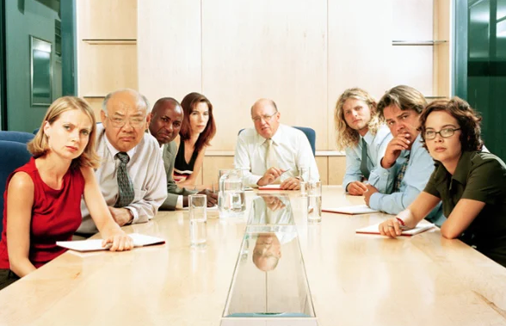
Negative Implications
Notes:
The CMO(Chief Marketing Officer) and the CSO(Chief Sales Officer) must understand that negative sentiments on social media can damage a brand's reputation and deter potential visitors. Maintaining A strong brand reputation directly influences a business's success and long-term sustainability.
Negative comments on social media platforms can harm a brand's image and reputation, leading to various consequences that can impact its overall success. Pamela from HubSpot states, “the internet and social media platforms make the comments from these meanies even more lasting and impressionable(Vaughan, 2022, pp.1).”
Unaddressed employee or customer concerns can decrease morale, impacting service quality and customer experiences.
Failure to ensure operational safety can lead to legal issues, negative publicity, and a decline in brand trust. According to Clearsy, Operational safety is the absence of risks, injury, or harm to the health of humans, both direct or indirect, resulting from damage to equipment or the environment. Risk analysis allows for determining how operational safety will guarantee protection against all risks. (Clearsy,n.d.).

Slide 5

Strategic Communication
Plan
Key Stakeholders
Communication needs
Mode of communication
Impact on stakeholders
Notes:
The Theme park must have a strategic communication plan. Two departments must plan for a successful customer and employee experience. “In the dynamic day-to-day of business leadership, understanding the distinct roles of a Chief Sales Officer (CSO) and a Chief Marketing Officer (CMO) is essential. Each position holds unique responsibilities and strategic importance. (Cannon, 2024, pp.1). The CSO and CMO must be:
• Interested in job security, safety protocols, and clear communication for employees.
•Seek reassurance on safety, enjoyable experiences, and transparent communication for Customers.
•Focus on compliance with regulations, public safety, and cooperation with Government Agencies.
Messages must be tailored modes of communication that address safety measures, reopening excitement and gratitude.
Utilize newsletters, social media, official statements, and feedback for effective communication and data collection.
There is an Impact on Stakeholders such as employees (safety, job security), a medium impact on customers (experience, safety), and a low impact on government agencies (regulatory compliance, safety). Stakeholder engagement is one of the core skills and key activities which enables this to happen successfully and effectively
There are several different ways to map stakeholders, including:
RACI Matrix
Power/interest grid
Influence / impact matrix
Remember not everyone is a stakeholder. Stakeholder have multiple projects going on and it is up to the PM to get projects managed and delivered.(Project Manager, 2013). It is important to document the stakeholders and know who they are by having a coffee meeting, or informal meeting and find out what they value out of the reopening of the theme park. From there, inform the team and get the team to know your stakeholders. The key stakeholders are:
COO(CHIEF OPERATIONS OFFICER )
CFO(CHIEF FINANCIAL OFFICER )
CMO(CHIEF MARKETING OFFICER )
CCO(CHIEF COMPLIANCE OFFICER )
CPO(CHIEF PEOPLE OFFICER )
CSO(CHIEF STRATEGY OFFICER )
and CSO(CHIEF SALES OFFICER)

Slide 6
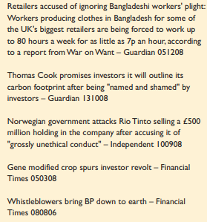
Strategic Communication
Plan(Case Study) Win-lose
(Cranfield University, 2009)
Notes:
Example of Win-lose or Win –destroy case study.

Slide 7
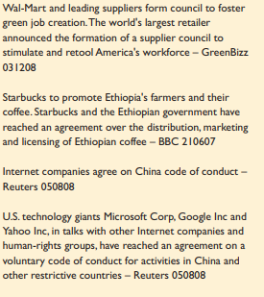
Strategic Communication
Plan(Case Study) Win-Win
(Cranfield University, 2009)
Notes:
Example case study from a newspaper article of win-win.

Slide 8
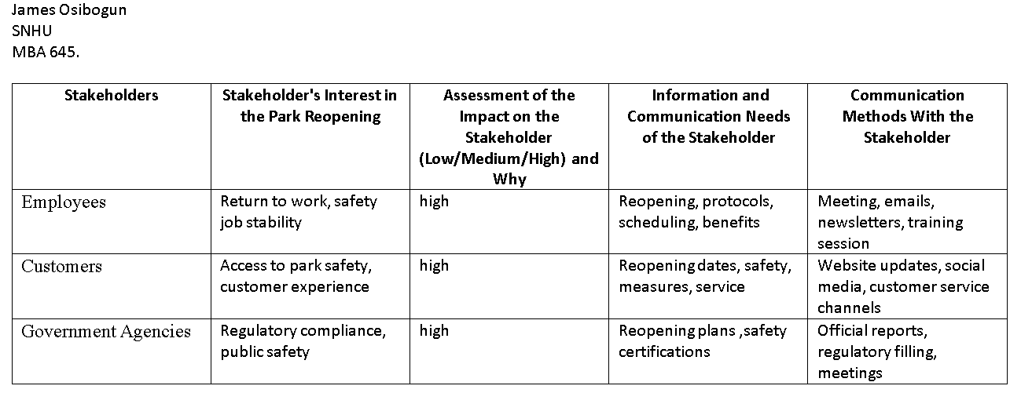
Notes:
Employees: Assessment of the impact is high due to changes in work schedules and safety protocols; Employees want to return to work as it directly affects their job stability. Communication are meetings and emails, training sessions.
Customers: Assessment of the impact is high for customer satisfaction; interested in a positive experience; interested in reopening dates, safety measures, available service and customer support.
Government Agencies: Assessment of the impact is high for legal requirements and safety certifications; communication needs for safety reports and reopening plans communication methods are regular filings, official reports and meeting.

Slide 9
Employees
Specific needs
Training sessions and announcements
Emails
Internal memos
2. Preferred communication channels
3. Expected impact of reopening
Notes:
Reopening the park requires that we notify the team of any adjustments you've made to workplace policies — well before you reopen your space(Fuchs, 2021). After that, provide training on new or modified working schedules. Ensure that the workspace is welcoming and well-prepared for employee occupancy(Fuchs,2021).
Specific Needs
Job Security: Assurances regarding job stability, potential retraining opportunities, and career advancement prospects. "Job security refers to the assurance employees have regarding the continuity of their employment within an organization, encompassing stability, potential for career growth, and protection from unexpected job loss."( Catalyst Whale, n.d.).
Safety Protocols: Adjusting administrative controls is another crucial consideration employers need to bear in mind when preparing for an office reopening(Fuchs, 2021). Detailed information on safety measures, training on new protocols, and access to protective equipment.
Clear Communication: Transparent updates on reopening plans, policy changes, and avenues for addressing concerns or feedback. To ensure the success of the implementation of the CRM is to train your employees(Flowflu, n.d.).
Preferred Communication Channels
Internal newsletters or emails: For official updates, safety guidelines, and HR announcements.
Virtual Town Hall Meetings are interactive sessions for addressing concerns, sharing updates, and fostering a sense of community.
Feedback Forms or Surveys: Platforms for employees to express feedback, suggestions, and concerns anonymously if needed. If your business culture still says that you are only driven by sales, you need to change it and make sure that all your employees acknowledge and embrace this change(Flowflu, n.d.).
Expected Impact of Reopening
High Impact: Increased job security, potential adjustments in work routines, and adaptation to new safety protocols.
Medium Impact: Emotional reassurance, adaptation to changing workplace dynamics.
Low Impact: Minimal disruption if effective communication and support mechanisms exist.

Slide 10
Customers
1.Specific needs
website updates
Social media post
Press release
Filing
Hotline
Forums meeting
2.Preferred communication channels
3. Expected impact of reopening
Notes:
Specific Needs
Safety Reassurance: Clear communication on safety measures, visible implementation of protocols, and hygiene standards for children 6-18 and teens 15-18 years of age.
Enjoyable Experiences: Assurance of enjoyable and memorable experiences despite safety measures, innovative offerings, and promotions for families whose annual income of more than $75,000 a year.
Transparent Communication: Openness about changes, refunds or rescheduling policies, and accessible customer support.
Preferred Communication Channels
Social Media: Platforms for announcements, updates, engaging content, and addressing customer queries or concerns.
Website and App: Information hub for safety guidelines, FAQs, booking options, and interactive features like live chat.
Email Marketing: Personalized updates, offers, and surveys for feedback and customer engagement.
Expected Impact of Reopening
High Impact: Customer trust, satisfaction, loyalty, and positive word-of-mouth.
Medium Impact: Adaptation to new experiences, potential changes in spending habits, cautious optimism.
Low Impact: Minimal disruption if communication is clear, and safety measures are effectively communicated and implemented.

Slide 11
Government Agencies
1. Specific needs
2. Preferred comms channels
3. Expected impact of reopening
Notes:
Specific Needs
Compliance with Regulations: Adherence to local, state, and federal regulations regarding safety, health, and operational standards.
Public Safety: Assurance of public safety measures, emergency response plans, and cooperation with authorities.
Cooperation: Transparency in communication, timely reporting of incidents or changes, and cooperation in inspections or audits.
Preferred Communication Channels
Official Correspondence: Formal letters, reports, and documents for regulatory compliance and updates.
Meetings or Calls: Direct communication with regulatory agencies for clarifications, approvals, and discussions on safety measures.
Compliance Portals: Online platforms for submitting reports, documentation, and receiving updates on regulatory changes.
Expected Impact of Reopening
High Impact: Regulatory compliance, public safety assurances, and positive relationships with authorities.
Medium Impact: Coordination efforts and potential procedure adjustments based on regulatory feedback.
Low Impact: There will be minimal disruption if proactive compliance measures are in place and communication with agencies is transparent and timely.

Slide 12
Fundamental Departmental Roles
1. Marketing
2. Operation
3. HR
Notes:
Marketing: Develops and implements reopening marketing campaigns, communicates safety measures, manages customer relations, and monitors brand sentiment. They focus on branding , marketing, public relations, advertising, and communications.
Operations: Ensures safety protocols are implemented, manages logistics for reopening, and maintains operational efficiency. They focus on people, safety and training.
Human Resources: Addresses employee concerns, hiring,conducts training on safety protocols, and fosters a positive work environment.(Functionly, n.d.).

Slide 13
Legal and Ethical considerations
1. CSR
2. Critical stakeholder Engagement
3. Avoid unethical Practices
Notes:
Corporate Social Responsibility (CSR): Align marketing efforts with TBL and CSR initiatives to enhance brand trust and appeal to socially conscious consumers. Highlighting CSR initiatives related to community support, environmental sustainability, and guest safety will be part of our communication strategy. Blogs, social media campaigns, press releases, CSR reports, and community events will be used to communicate our CSR efforts effectively(Weinger, n.d.).
Critical Stakeholder Engagement: Involve stakeholders in marketing and communications to ensure transparency and trust.
Avoid Unethical Practices: Clear false advertising, unethical data collection, negative advertising, and pricing strategies to maintain brand integrity and legality(Pennstate, n .d.) . A belief that owners have when they think they are doing right by business. For example, Not converting profit into cash or poor capital management, excessive capital expenditure, thinking they know the customer well, not developing a management team, a customized or bespoke offering(Ireland, 2022).

Slide 14

Marketing the Brand By James Osibogun SNHU Professor Fletcher April 27, 2024

Slide 15

Agenda
Methods to be used for consumer research
Digital marketing methods
Traditional and digital marketing methods you have selected will work together to optimize the brand
Crisis management strategies
One legal and one ethical issue
Reference
Notes:
As the regional marketing director for a southeastern U.S. theme park, we are crafting a marketing plan for the park's reopening that aligns with your CMO's directives. This plan will be customized for your park and shared with other regional marketing directors for their respective parks.
The strategic marketing plan will cover traditional and digital marketing methods, crisis management strategies pre-reopening, legal and ethical considerations, and methods for consumer research. We'll also explore how traditional and digital marketing methods complement each other to enhance the brand.
Digital marketing has become vital to an organization's overall marketing strategy by allowing organizations to create messages that reach a specific audience, who are likely to be interested in their product(Guataven, 2023). We analyzed the brand implications for the theme park to reopen. We created a customizable strategic marketing plan to implement for the park and shared it with the other regional marketing directors by implementing a strategy based on the needs and demographics.

Slide 16

Methods for Consumer Research
Notes:
The CMO must use consumer research to help understand the psychology of the consumer. This psychology practice helps the researcher create a detailed purchasing behavior profile(Bhat, n.d.). Consumer research is a methodology for gaining reliable data about specific markets and target customers. Consumer research organizations and industry associations provide data and statistical reports on markets and future trends(Queensland government, n.d.). The data used helps the company analyze trends. It allows them to make short-term and long-term decisions. Bhat(n.d., p. 4) argues,” Carrying out a consumer electronics survey can be helpful to understand the market demand.”
Conducting research on improving brand equity requires strategy, development, and tracking. It must also align with consumers' ways of thinking when they purchase a product or service. Consumer research aims to boost sales(Bhat, n.d).
We can use quantitative and qualitative data for CX(Customer Experience). We can use CX for long-term qualitative data for KPIs, and we can use quantitative data for sorting out and organizing statistical analysis responses(Chambers, 2023). Research methods are interviews, surveys, and feedback software like Delighted, Nice Reply, Survey Lab, Pollfish, and HubSpot.

Slide 17

Traditional Marketing methods
Notes:
Traditional marketing methods for reopening the park will require a lot of resources and materials for a conventional marketing channel, such as phone calls, face-to-face meetings, direct mail, print, advertisements, speaking engagements, networking, and Broadcasting. For the park's reopening, we will select using print ads, direct mail, and billboard marketing.

Slide 18
Digital Marketing Methods: 1. Email 2. Social media 3.Influencer marketing
Notes:
CMOs can use three digital marketing methods: Email, Social media, and Influencer marketing. The three picks are crucial to opening the theme park. Email our loyal customers to request the reopening of the park. We can also use social media to contact Theme Park followers by targeting young and older adults through Facebook, TikTok, and Twitter.
We can use networking to find an influencer who can speak to our loyal demographic, such as a YouTuber, country singer, or pop artist. The influencer will help the park build a relationship with our brand, not sales of the product or service(MailChimp, n.d.).
We can use email marketing, which allows the company to utilize content marketing tools such as automation and personalization.

Slide 19

Traditional and Digital Marketing to optimize brands
Notes:
Traditional and digital marketing methods work together to optimize the brand for the target audience. The odds may seem stacked in favor of marketing. However, a shift is underway as marketers predicted that traditional advertising spending increase by 1.4% and 2.9%(AMA, 2022). So, there is still a demographic that prefers traditional marketing. To win Gen Z business, we must create a marketing narrative that young adults can connect with(AMA, 2022). The potential to transform the company through long-term growth can make it a powerhouse in your industry(Shirey, n.d.).
Traditional marketing includes:
•Print (magazines, newspapers)
•Broadcast (television, radio)
•Direct mail
•Telemarketing
Digital Marketing
•SEO
•PPC
•Content marketing
•Email marketing
•Social media marketing

Slide 20

Traditional and Digital Marketing to Optimize brands cont’d
Notes:
Both digital and traditional marketing “support the brand and growth of the business.”(SNHU, n.d.). For example, Coca-Cola uses digital and traditional marketing to promote the brand. “Traditional and digital marketing simultaneously can yield some insane results for your business(Shirey, n.d.). “Everyone can access televisions, radios, newspapers, and other entertainment media that thrive on advertising. Shirey( n.d., p. 3) said that out of all the people in America alone, only 99% of all families own a television(It is used both traditionally and digitally, where ads can promote brands.

Slide 21

Crisis management strategies
Notes:
Crisis management strategies must be implemented prior to reopening with a focus on customer expectations to improve brand damage from the incident. We need to:
•Practice A 'What Would Happen If...' Exercise- creates employee and customer safety.
•Learn Resilience And Accept Vulnerability
•Change According To The Times And Your People
•Form A Crisis Management Team
• Identify Your Key Risks
•Prioritize A 'Crisis Focus' With The Team
• Forget Traditional Hierarchical Barriers
•Outsource The Development Of A Framework
•Plan On Adjusting To Many Unknowns- Things can happen before and after the parks open. It is good to be prepared and have phones to call 911.
•Document Processes And Do Drills- schedule work hours to practice drills
•Work Backward On A Plan To Fail
•Share A Communication Plan With All Teams, top-down and down the hierarchy.
•Take Responsibility For Any Crisis(Forbes, 2020).

Slide 22

Legal and Ethical Issues
Notes:
A negative impact on the organization's brand image upon reopening—legal issues like harassment, discrimination, whistleblowing, ethics in accounting, and espionage. Marketers can target advertising campaigns based on targeted demographics and user data in digital marketing(Hyatt, 2023). The advertising firm needs careful consideration for this type of targeted targeting(Hyatt, 2023). Conflicts of interest occur when individuals or groups have competing personal or professional interests that may compromise their ability to act objectively and in the organization's best interest(Hyatt, 2023). Organizational conflict and ethical decision-making are closely linked because conflicts often involve ethical dilemmas requiring thoughtful consideration and analysis. Role conflicts emerge when individuals or groups have conflicting expectations or demands placed upon them(Hyatt, 2023).
These conflicts can arise from unclear job responsibilities, overlapping roles, conflicting priorities, or organizational or departmental goals differences. Conflicts between strategy and execution occur when there is a disconnect between the organization's strategic goals or objectives and the ability to implement or execute those strategies effectively(Hyatt, 2023).
In conclusion, having a digital presence and a traditional presence is essential. Before embarking on content creation and campaign development, it is vital to consider the target audience. Whether creating a banner ad, writing a blog article, or crafting a social media post, it is essential to identify the target audience. Targeting "everyone" is neither wise nor feasible(SMU, 2023). Reopening the theme park benefits employees, customers, and the community.

Slide 23
Legal and Ethical Issues(training and accountability)
Notes:
HR(Human Resources) needs to provide their employees with training. The law promotes training and lowers the organization's potential liability to its employees(Sage, 2020). OSHA implemented safety standards for worker safety and health by providing employee training. If employers do not provide training that is OSHA standard, it is considered a violation of OSHA. Employers can be liable for damages caused by employees who were not trained and not ready for work.

Slide 24
Agenda
Clearly state 2 SMART goals, then justify your goal by addressing:
Is it Specific
Is it Measurable
Is it Achievable
Is it Realistic
Is it Time-Bound
Clearly state a KPI that will help you track each of these 2 SMART goals
Clearly state what tools you'll use to monitor each of these KPIs, in support of your SMART goals
Feedback loops
References
Notes:
Today's Agenda will discuss two SMART goals and why they are essential. We will also discuss KPI to track SMART goals and what software tools to monitor and track them.

Slide 25
Introduction
Notes:
The theme park is opening in a few months, so a few things must be discussed. After the safety incident, the park must reevaluate the steps to reopen it. We must utilize tools for branding, keeping track of social media accounts, views, and ads on the site page, engagement in the comments, updating FAQs, service lines, emergency contacts, maps, ticket purchases, refunds, attire for workers, and a pleasant webpage.
We will discuss and Introduce the purpose of the presentation by sharing marketing objectives, success criteria, and methods for monitoring and measuring results.

Slide 26
Marketing Strategies Overview
Notes:
Align the business strategy with the SMART objective and explain business goals, target market, buyer personas, competitors, and customer value.
Marketing is about connecting the company with potential customers and connecting those customers with its products. It involves understanding customer needs, translating them into products and services, packing and pricing them, and convincing customers to buy them (Optimizely,n.d.).

Slide 27
Increase Brand Awareness
Specific | Enhance brand recognition across all parks. | 90% of consumers spend more on brands they trust(Consumer report, n.d.).
Measurable: | Increase brand mentions on social media by 30%.
Achievable: | Leverage social media campaigns and influencer partnerships. | An excellent strategy to drive social media mentions using influencers(Keyhole, 2018). Refining our approach, we can leverage influencers to drive social media mentions and achieve marketing objectives.
Realistic | The current level of brand visibility and industry benchmarks. | When measuring brand awareness, think of it as a popularity contest where you find out who’s leading the race(Shahid, 2024)
Time-Bound | Achieve the goal within the next six months.
Notes:
To enhance brand awareness among our target audience, we will increase brand mentions on social media by 30% within six months.
Specific: The goal clearly outlines what needs to be achieved - an increase in brand mentions on social media. It specifies the platform (social media) and the desired outcome (enhanced brand awareness).
Measurable: The goal is quantifiable, with a target of a 30% increase in brand mentions. This allows for easy tracking and measurement of progress.
Achievable: The goal is realistic and attainable within a 6-month timeframe. It considers current brand awareness levels and sets a challenging yet reachable target.
Realistic: The goal aligns with the organization's resources, capabilities, and marketing strategies. It considers audience engagement, content quality, and social media presence.
Timely: The goal has a defined timeframe of 6 months, providing a sense of urgency and focus. This ensures that efforts are concentrated, and results are achieved within a reasonable period.
To measure brand visibility, the marketing team must:
•Customer sentiment
•Branded search volume
•Customer surveys
•Google Trends data
•Share of voice
•Earned media
•Referral traffic and backlinks
•Search Traffic
•Conversions
•Social media engagement(Shahid, 2024)

Slide 28

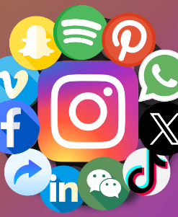
KPI Identification hods for
Social media and Online tickets sales
Notes:
The KPI for ticket sales volume measures the total number of tickets sold over a specific period. It indicates your sales performance and overall demand for your event or product.
The conversion rate calculates the percentage of website visitors, leads, or prospects who ultimately purchase tickets through funnels and marketing campaigns that convert potential customers into actual buyers.

Slide 29
Monitoring Results methods for KPIs
Social media and Online tickets sales
Notes:
Use social media monitoring tools to track brand mentions and conduct sentiment analysis. SproutSocial allows you to track brand mentions on a global or campaign level. You can use it to identify sentiment and investigate customer preferences and behavior to determine your target audience (Zivkovic, 2024).
Utilize Google Analytics or CRM software to monitor conversion rates from online ticket sales. By integrating CRM data with Google Analytics, marketers can increase revenue by identifying the most profitable marketing channels and making informed decisions to drive more qualified leads and sales(Holmes, 2021)

Slide 30
Feedback Loops
Notes:
Establish feedback loops for both objectives to gather insights and make data-driven decisions. To Get Better Customer Data, Build Feedback Loops into our Products(Wright, 2023). The combination of user data and AI often creates data feedback loops. Data feedback loops can help create a sustainable competitive advantage, provided certain conditions exist. (Wright, 2023). However, the strength of these data feedback loops can vary greatly, and companies can make deliberate choices in their products or services to strengthen them(Wright, 2023).
Conduct monthly meetings with park marketing teams to review performance and adjust strategies. To enhance the visitor experience, we can use the feedback loops for
•Guest satisfaction- collect feedback from surveys, kiosks, mobile apps, and online reviews. We can analyze and use the feedback to follow trends, joint issues, and cleanliness. Based on the analysis, follow up by addressing the issues, concerns, feedback scores, guest retention, and improving ride maintenance.
•Operation- safety concerns, equipment malfunctions, staff issues. We can monitor critical operations and implement safety protocols.
•Marketing and promotion- used for campaigns, offers, social media, and advertising. We will analyze feedback data to assess marketing strategies, brand perception, and ROI. KPI will be used for web traffic, conversion rates, ticket sales, demographics, and social media.

Slide 31
Reporting
Notes:
Provide comprehensive monthly reports to the CMO and regional marketing directors. Include KPI performance, insights, challenges, successes, and proposed actions for improvement.

Slide 32
Continuous Improvement Process
Act
Plan
Check
Do
Continuous Improvement Process
Notes:
Defining the theme park's brand identity involves clearly articulating its mission, values, unique selling proposition (USP), target audience, and brand personality to distinguish it in the market and communicate why customers should choose it. (Optimizely, n.d.). The theme park must ask themselves how it differs from other theme parks. This process also includes setting brand standards, which entails establishing guidelines for visual identity, brand messaging, customer experience, and brand positioning. Identifying key metrics is crucial, as it involves determining key performance indicators (KPIs) related to brand identity and reputation, such as brand awareness, brand sentiment, customer loyalty, and brand equity, which can measure the success of brand-building efforts and guide strategic decision-making.
Continuous improvement of the park involves:
•The products or services you offer your customers.
•Your offerings benefit customers that they can't get from the competition.
•Who your target customer is?
•The problem you're solving for customers.
The PDCA cycle aims to eliminate those issues with a four-step process based on a plan for the desired change in the organization. It involves putting ideas in motion using proper communication amongst the team, checking how the plan worked in a controlled environment, asking where the goals were achieved, identifying the flaws, and acting to ensure the plan is working(Green, 2022).

Slide 33
Method to Address Negative Public Perceptions
Two marketing strategies to address negative feedback
Public relations and crisis management
Notes:
Proactive Engagement and Transparency are pivotal in managing negative public feedback on social media. Utilizing a Public Relations Approach involves actively engaging with the public and addressing negative feedback transparently by regularly monitoring social media channels for adverse comments, reviews, or mentions related to the brand. Visavadiya( 2024, pp. 23) argues ,”a crisis management plan should also be in place, outlining protocols for responding swiftly and effectively to negative feedback. This includes designating a team responsible for handling PR and crisis communications, developing a response strategy that acknowledges concerns empathetically, provides information or solutions, and emphasizes transparency and authenticity in communication.” Encouraging customer engagement and inviting direct feedback and constructive dialogue are vital to showcase a commitment to customer satisfaction(Bennett, 2023,pp. 22). Following up with dissatisfied customers and providing updates on issue resolution demonstrates accountability and continuous improvement. So, reputation management and positive messaging strategies involve implementing reputation monitoring tools to track sentiments, launching positive campaigns highlighting brand strengths and customer experiences, cultivating brand advocates, creating educational content, engaging with online communities, and continuously monitoring and adjusting marketing strategies based on data analytics(Barnhart, 2024, pp.29). This integrated approach helps address negative feedback effectively, mitigate reputational risks, and enhance brand resilience in challenging situations.
It is important to have s swift response by creating rapid response protocols and implement monitoring tools for social listening to monitor conversions, mentions and anything related to the brand.

Slide 34

Reference
Notes:
Consumer Report (n.d.). Elevate your brand with trusted leader in consumer trust. https://www.consumerreports.org/brand-licensing/?utm_source=google&utm_medium=cpc&utm_campaign=ng_cr_search_nb_general&utm_content=enhance%20brand%20value&gad_source=1&gclid=CjwKCAjwz42xBhB9EiwA48pT74zk9g8jR9QcVrUDa18AjnDX62xlk1uX1FO93Injg7jrqVPpwIg1exoCgToQAvD_BwE
Rheude, J (December 15, 2023). Demand forecasting: Types methods and examples. https://redstagfulfillment.com/what-is-demand-forecasting/
Optimizely (n.d.). Marketing Strategy. https://www.optimizely.com/optimization-glossary/marketing-strategy/
CFI (n.d.) Resource management smart tools. https://corporatefinanceinstitute.com/resources/management/smart-goal/#:~:text=The%20Importance%20of%20SMART%20Goal%20Setting&text=SMART%20goals%20set%20you%20up,organize%20and%20reach%20your%20goals.
Stockopedia (n.d.). Sales growth TTM. https://www.stockopedia.com/ratios/sales-growth-ttm-838/
Shahid, K ( January 11, 2024).How to measure brand awareness: 10 metrics to track. https://sproutsocial.com/insights/how-to-measure-brand-awareness/
Holmes, K (March 17, 2021) How to integrate CRM data with Google analytics for closed loop reporting. https://www.ruleranalytics.com/blog/analytics/google-analytics-crm/
Zivkovic, M ( March 20, 2024). Top 10 social media monitoring tools for PR pro- a 2024 list. https://prowly.com/magazine/social-media-monitoring-tools/#:~:text=With%20SproutSocial%2C%20you%20can%20track,your%20target%20audience%20really%20is.

Slide 35
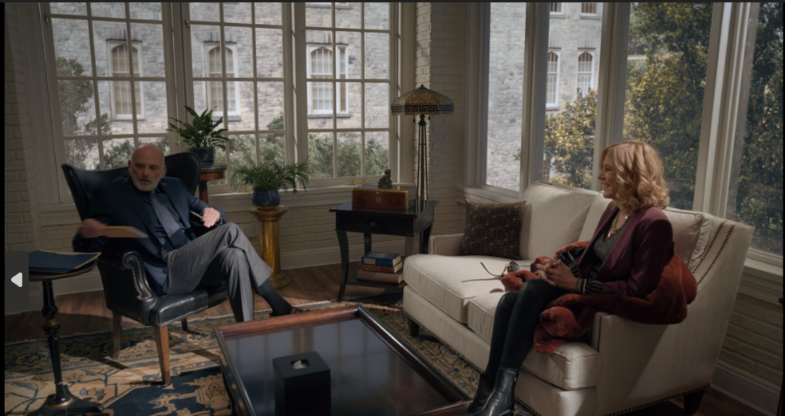
Reference:
Notes:
Ireland, C (November 7, 2022). 5 things that destroy a company’s value. https://www.crowe.com/ie/insights/5-things-that-destroy-a-companys-value
Weinger, A (n.d.). What is the impact of CSR? FAQ and key benefits for businesshttps://doublethedonation.com/how-csr-impacts-businesses/
Fuchs, J (March 17, 2021). Workplace reopening's are on the horizon: Here how to prepare. https://blog.hubspot.com/sales/how-to-prepare-a-workplace-for-reopening
Grayson, D( July 2009). Stakeholder Engagement: A road map to meaningful engagement. https://www.fundacionseres.org/lists/informes/attachments/1118/stakeholder%20engagement.pdf
Project Manager(December 2, 2013). Project Stakeholder Management Plan: Managing Expectations! [Video]. https://www.youtube.com/watch?v=0EkufUCo5qI
Miller, A (n.d.). Proactive Crisis Management. https://www.leavitt.com/leavittpacific/docs/Newsletter_Crisis-Management_AlexMiller.pdf
Chen, J (Published on February 18, 2020 ). Why brands need social media monitoring. https://sproutsocial.com/insights/social-media-monitoring/
Cannon, W (March 2, 2024). Chief Sales Officer vs Chief Marketing Officer: Role + Differences.https://www.uplead.com/chief-sales-officer-vs-chief-marketing-officer/#:~:text=In%20the%20dynamic%20day%2Dto,unique%20responsibilities%20and%20strategic%20importance.
Flowflu (n.d.). What Are The 4 Pillars Of CRM?https://www.flowlu.com/crm-guide/pillars-of-crm/#:~:text=To%20ensure%20that%20you%20implement,to%20help%20grow%20your%20business.
Barron, S (July 6, 2023). Customer loyalty and retention 13 ways to improve yours. https://blog.hubspot.com/service/customer-retention-and-loyalty
Carmichael, K (July 28, 2020).The plain English guide to brand equity. https://blog.hubspot.com/marketing/brand-equity
Digital Whale(n.d.). Is Enterprise A Good Place To Work . https://www.thedigitalwhale.com/post-is-enterprise-a-good-place-to-work/
Big Commerce (n.d.).What is Brand Equity? https://www.bigcommerce.com/glossary/brand-equity/
Hayes, A (October 27, 2023).Brand Equity: Definition, Importance, Effect on Profit Margin, and Examples. https://www.investopedia.com/terms/b/brandequity.asp#:~:text=Brand%20equity%20is%20important%20for,a%20more%20stable%20customer%20base.
Ipsos (22 May 2020). Reopen with Confidence: Ensuring Consumers Feel Safe in the 6-Foot Economy
https://www.ipsos.com/en-us/knowledge/customer-experience/making-customers-feel-safe-6-foot-economy
Leibowitz, C( March 3, 2022). What Is Public Relations and Why Is PR Important?
https://www.5wpr.com/new/what-is-public-relations-and-why-is-it-important/
Linezero( July 27, 2023). HOW DOES POSITIVE EMPLOYEE EXPERIENCE AFFECT CUSTOMER EXPERIENCE?
https://www.linezero.com/blog/employee-and-customer-experience
Gupta, D( n.d.). HOW DO BRANDS HANDLE NEGATIVE COMMENTS ON SOCIAL MEDIA?
https://bulk.ly/negative-comments-on-social-media/
Clearsy(n.d.).Operational Safety.https://www.clearsy.com/en/thematics/operational-safety/
Functionly (n.d.). Functional Areas of a Business
https://www.functionly.com/orginometry/business-functions/functional-areas
Pennstate University (n.d.). CHAPTER 8 – ETHICAL AND LEGAL CONSIDERATIONS
https://psu.pb.unizin.org/comm370/chapter/chapter-8-ethical-and-legal-copnsiderations/

Slide 36

Reference
Notes:
Green, S (January 12, 2022). What Is PDCA? Understanding the Plan-Do-Check-Act Method
https://blog.hubspot.com/marketing/pdca-cycle-model
Bennett, M (November 27, 2023). Reputation management strategy guide. https://broadly.com/blog/reputation-management-strategy/
Visavadiya , D (January 22, 2024). Social media crisis management: How to handle negative feedback and protect your brand. https://www.agilitypr.com/pr-news/public-relations/social-media-crisis-management-how-to-handle-negative-feedback-and-protect-your-brand/#:~:text=When%20faced%20with%20negative%20feedback,the%20situation%20from%20escalating%20further.
Barnhart, B (January 18, 2024). Social media reputation management: How to stay in good standing with your audience. https://sproutsocial.com/insights/social-media-reputation-management/
Huffman, J(May 3, 2023). Unique selling proposition What it is and how to develop a great one. https://blog.hubspot.com/sales/unique-selling-proposition#what-is-a-usp
Optimizely (n.d.).Unique selling point. https://www.optimizely.com/optimization-glossary/unique-selling-point/
Mailchimp (n.d.) What are marketing channels? https://mailchimp.com/resources/what-are-marketing-channels/
Chambers, S( January 20, 2023). Everything you need to know about customer experience research. https://blog.hubspot.com/service/customer-experience-research#what
Bhat, A(n.d.). Consumer research: example process and scope. https://www.questionpro.com/blog/consumer-research/#:~:text=What%20is%20Consumer%20Research%3F,create%20detailed%20purchasing%20behavior%20profiles.
Queensland business(n.d.). Planning and conduction market and customer research. https://www.business.qld.gov.au/running-business/marketing-sales/market-customer-research/plan-conduct
Ruparelia, A (March 5, 2022), 8 Types of traditional marketing methods to implement. https://salespanel.io/blog/marketing/traditional-marketing-methods/
Delighted( n.d.). 4 simple and powerful customers retention strategies. https://delighted.com/blog/improving-customer-retention-strategies
Putler(March 15, 2024) Customer retention” the ultimate guidebook to reduce customer churn. https://www.putler.com/customer-retention/#:~:text=Customer%20retention%20is%20vital%20for,develop%20and%20grow%20business%20value.
Guataven, A(August 10, 2023) From SEO to Social media: What are the 8 types of digital marketing. https://www.snhu.edu/about-us/newsroom/business/types-of-digital-marketing
Eminence( n.d.). SEO migration: McDonalds. https://eminence.ch/en/portfolio-item/mcdonalds-seo-2/#gref
Taylor, R (December 15, 2021) Why a good marketing strategy takes time. https://yorcmo.com/why-a-good-marketing-strategy-takes-time/#:~:text=Monitoring%20Campaign%20Effectiveness%20is%20Time%2DConsuming&text=Depending%20on%20your%20ad%20metrics,buying%20your%20types%20of%20products.
AMA (July 27, 2022). How can traditional and digital marketing work together? https://www.ama.org/marketing-news/how-can-traditional-and-digital-marketing-work-together/
Peters, B (July 29, 2022). Can Gen Z reached through traditional marketing channels. https://amaboston.org/blog/can-gen-z-be-reached-through-traditional-marketing-channels/
Shirey, T (n.d.). How traditional and digital marketing work together. https://www.webfx.com/blog/marketing/how-traditional-and-digital-marketing-work-together/#:~:text=Combined%2C%20traditional%20and%20digital%20marketing,a%20powerhouse%20in%20your%20industry.
Forbes( September 16, 2020). 14 ways to build a solid crisis management strategy. https://www.forbes.com/sites/forbescoachescouncil/2020/09/16/14-ways-to-build-a-solid-crisis-management-strategy/?sh=79c24d1b5a89
SMU( July 20, 2023).The importance of having a digital prescenece and how to leverage digital marketing in todays crowded marketplace. https://academy.smu.edu.sg/insights/importance-having-digital-presence-and-how-leverage-digital-marketing-todays-crowded

